Slide 2
Netflix

Slide 3
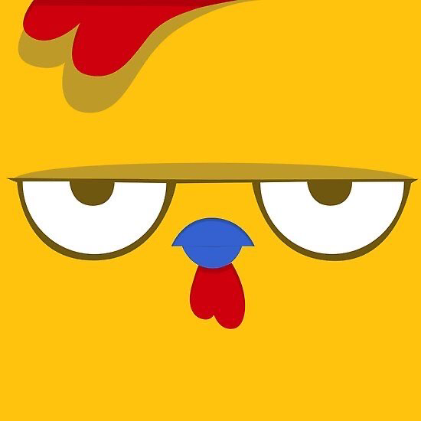
Netflix
What’s to Report?
Report 1
Report 2
Report 3
Report 4
MANAGE REPORTS

Slide 4
Netflix
Home
TV Shows
Movies
New & Popular
My List
KIDS
Project Soar
BY LITZY SANCHEZ
Play
More Info
Credits to GemoEdits

Slide 5
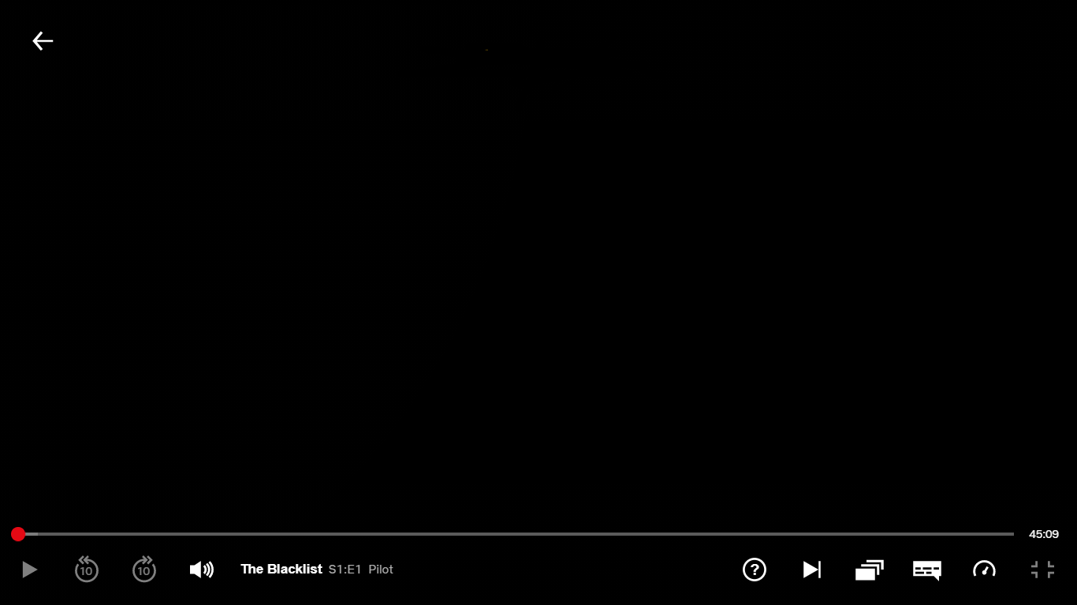
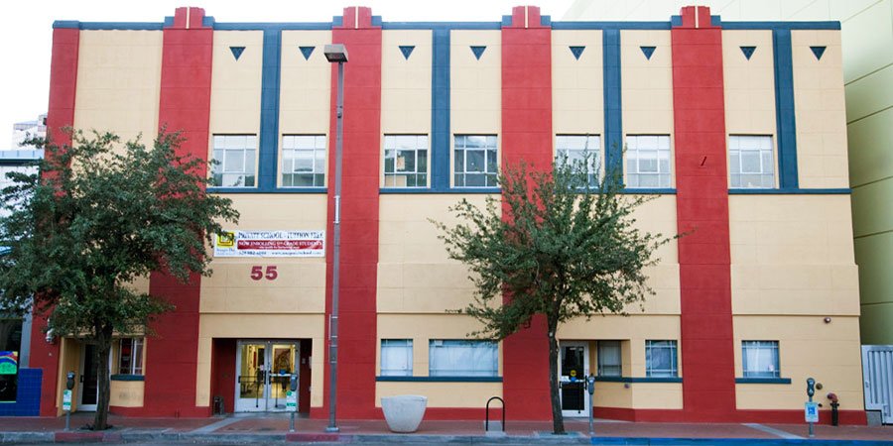
Beginning Thoughts
1
I joined the class for the Gen Ed credit and was expecting to learn more about humans for my major. I was nervous based off the description. I thought the course was going to be hard based on looking through the syllabus. When I was placed into Imago Dei and went to my first session. I was very nervous and quiet. I tried my best to communicate with my mentees as they did with me.
SUB TOPIC Part 1

Slide 6
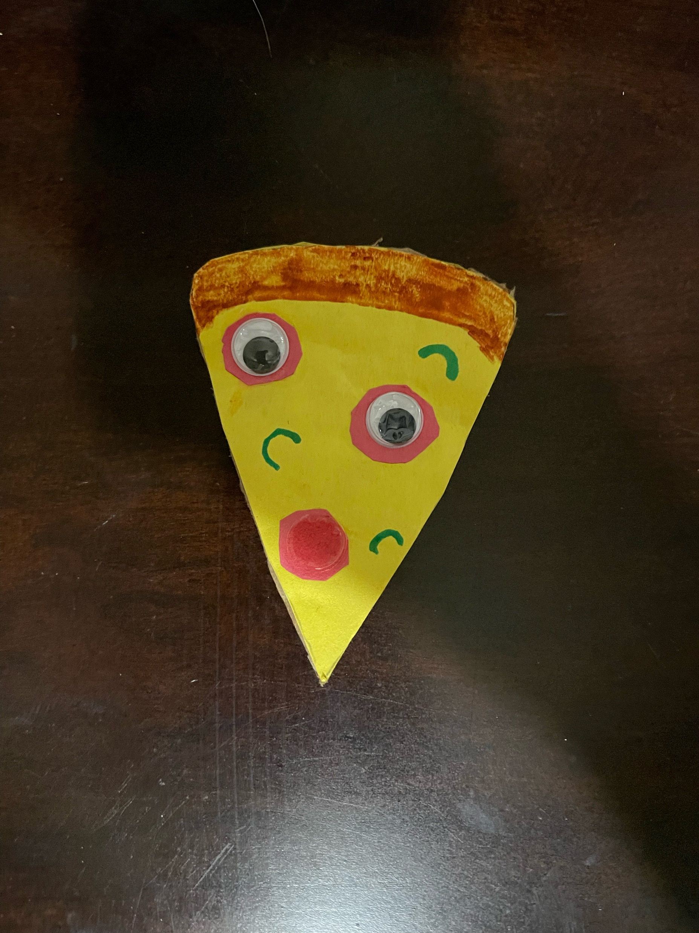
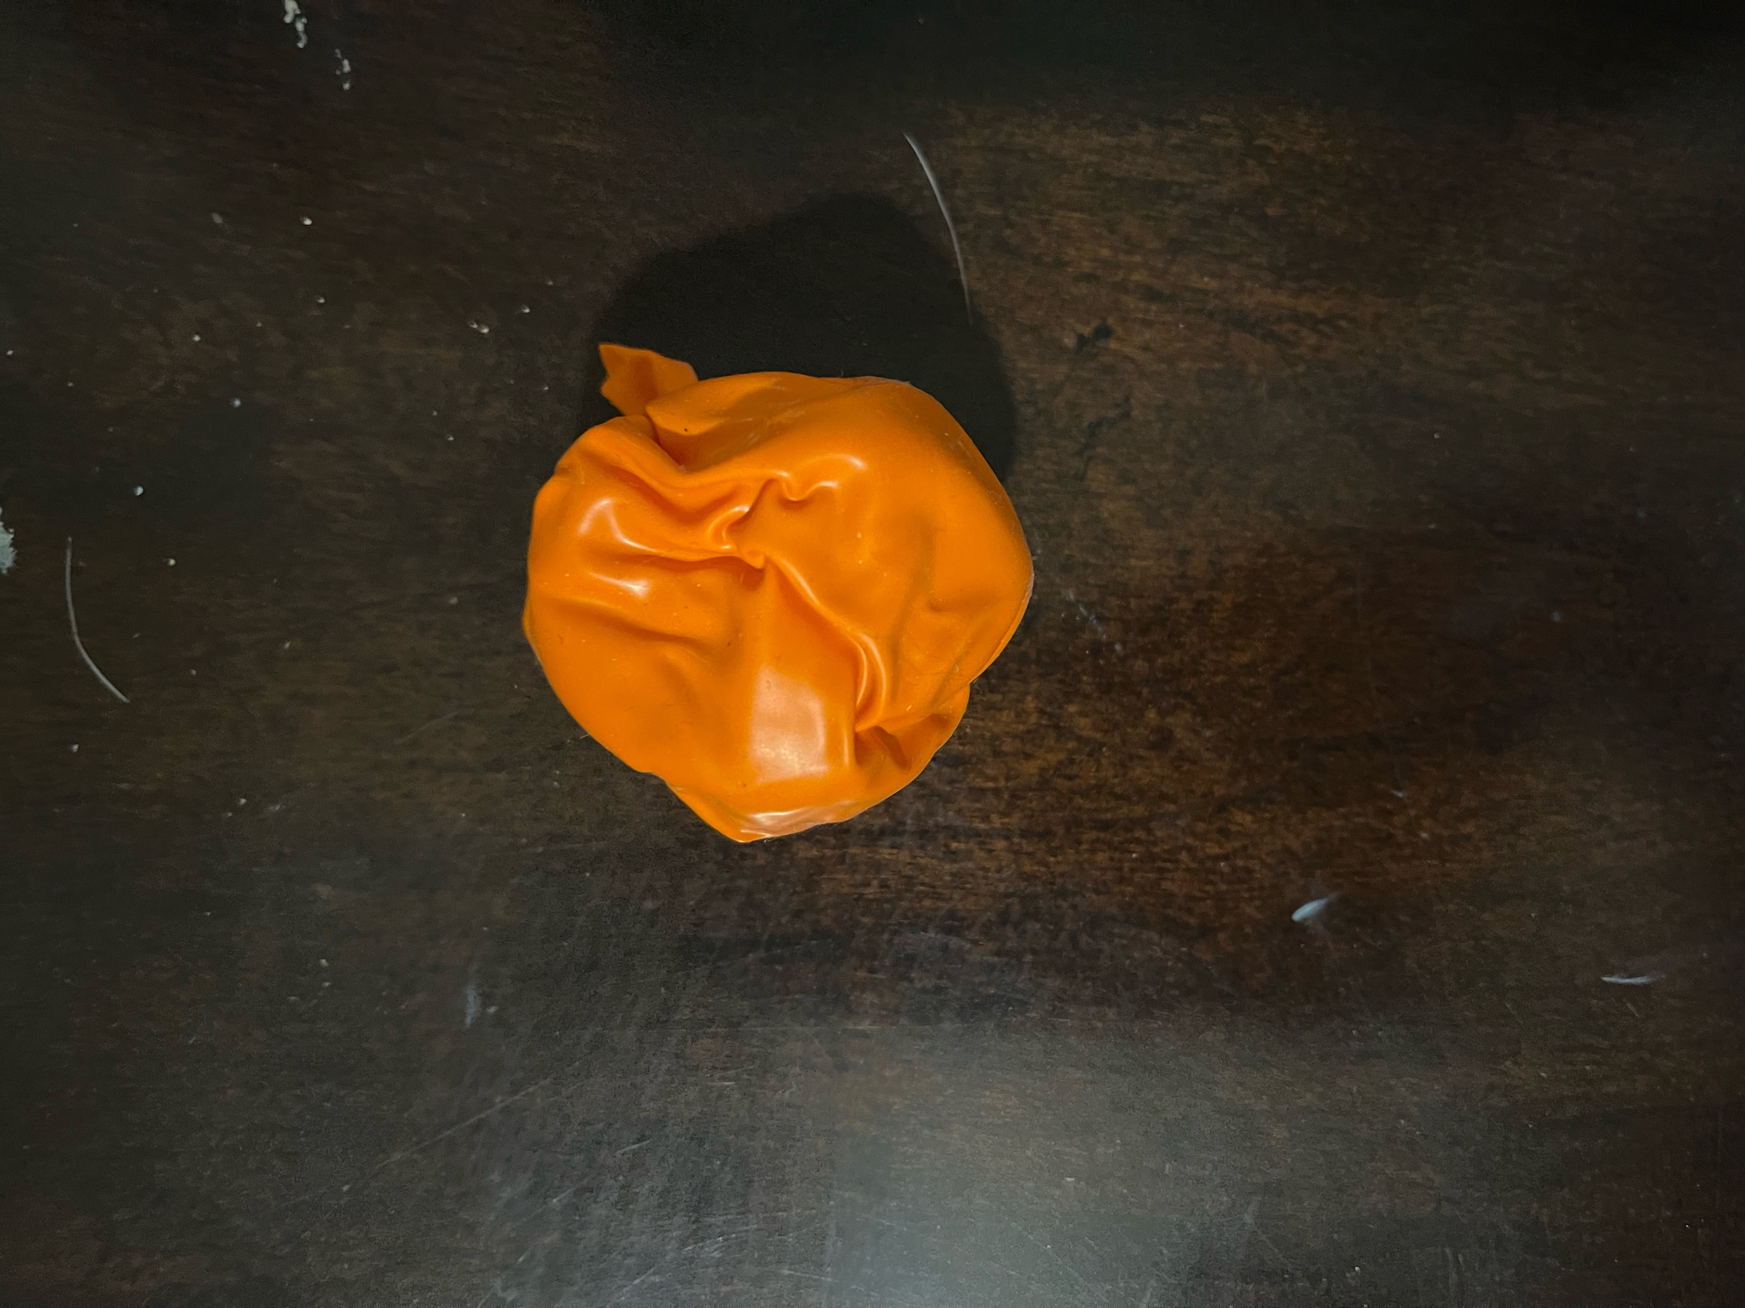
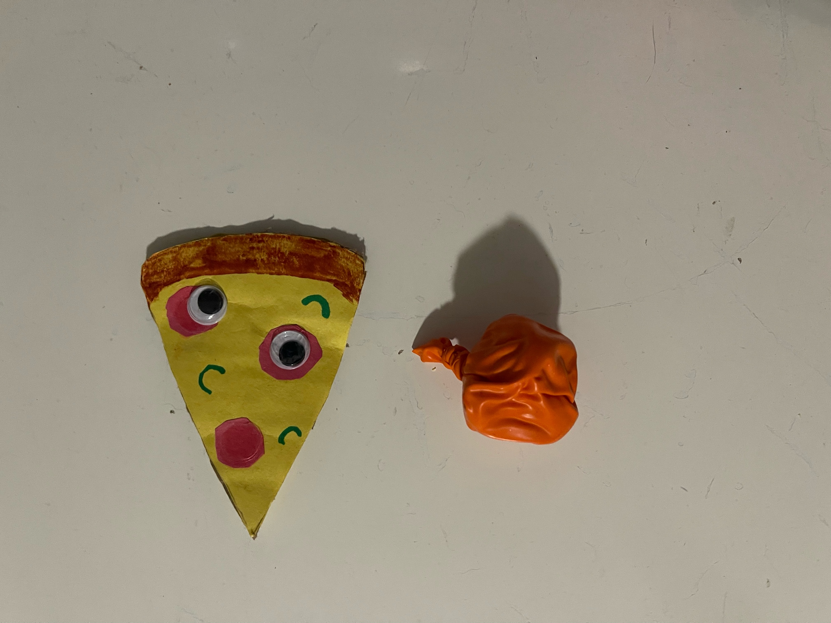
2
Activity
DIY FIDGET TOYS
MATERIALS: googly eyes, cardboard, glue, balloon, play doh, scissors, markers and colorful paper
For my activity with my mentees, we decided together to make fidget toys. This activity is a good way to do hands on work. Although fidget toys are viewed as a distraction. They help a lot with anxiety. Fidget toys cost a lot of money these days and most can’t afford to buy the toy. A few items around the house can offer a lot into creating our own. My mentees enjoyed this activity. They had a lot of fun and enjoy using their abilities to create something of their own.
SUB TOPIC Part 2

Slide 7
Final Thoughts
3
My mentoring session has let me grow within myself but my abilities. I was able to use my creative mind and expand my ideas further. I’m able to joke around with my mentees. I learned a lot. I was able to take a risk towards this class. I expected the worse to happen. Although, mentoring for my mentees has been the best thing possible to happen to me. I cherish our memories. I was able to grow with them. I learned a lot about myself during the process. The class has provided many supplies and support towards our process. This is my first year at the university, it is a big change to high school. So it’s the same for our mentees, their first year into middle school. I was able to relate with them in a lot of things. This experience has been amazing.
SUB TOPIC Part 3

Slide 8
Netflix
Home
TV Shows
Movies
New & Popular
My List
KIDS
THANK YOU
FOR LISTENING!
Sign In
100% Done
By: Litzy Sanchez
Subject: HED 350 Student Outreach
Teacher: Jamaica Delmar & Yadira Oregon
Sign Out
Questions? Clarifications FAQ About Us Help Center

